Slide 1
The case for a Caribbean debt initiative
Sheldon Mc Lean, Coordinator, Economic Development Unit, ECLAC subregional headquarters for the Caribbean

Slide 2
Outline
Caribbean debt challenge
Heterogeneity of Caribbean debt
ECLAC’s Debt Reduction Scenario analysis
The Way Forward
The Caribbean’s major challenges
Developing ECLAC’s Caribbean Resilience Fund
Environmental vulnerabilities

Slide 3
The Caribbean is faced with high public debt and low growth
Source: ECLAC, based on official figures.

Slide 4
The major challenges facing the Caribbean
INSUFFICIENT PRODUCTIVITY & COMPETITIVENESS
HUMAN DEVELOPMENT
CHALLENGES
MACROECONOMIC
IMBALANCES
ENVIRONMENTAL
CHALLENGES
Implementation and Regional approach gaps

Slide 5
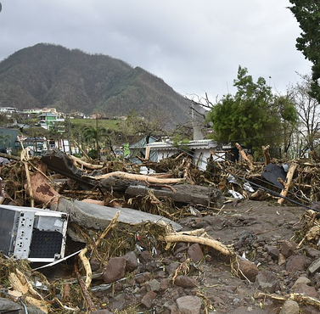
The subregion is highly vulnerable to climate changes, natural disasters and weather events
Caribbean countries are some of the most vulnerable to climate change
Even among SIDS, natural disasters are more costly and more frequent in the Caribbean.
In 2017, the cost of the hurricane season to Caribbean countries was US$93 billion (this includes Cuba US$13b and Puerto Rico US$68 billion).
ECLAC has estimated that in 2017, damage and loss to Antigua and Barbuda, The Bahamas, Dominica and Saint Kitts and Nevis due to hurricanes were in excess of US$1.7 billion.
Damage to infrastructure, agriculture and housing following the eruption of the La Soufriere volcano in Saint Vincent and the Grenadines estimated at US$300 million.
Caribbean governments need to respond after these events, often through more debt

Slide 6
ECLAC’s Debt Reduction Scenarios Analysis – Phase I countries

Slide 7
Heterogeneity of debt requires tailor-made debt reduction scenarios
Source: ECLAC, based on official figures.

Slide 8
Scenario Analysis Process Chart Initial CRF capitalization for Phase I countries of US$527 million
STEP 1
Target growth set at 1%
STEP 2a
Long-term elasticity of debt on growth: 0.082
STEP 2b
Required total debt reduction: 12.2% of GDP
Antigua and Barbuda
Saint Lucia
Saint Vincent and the Grenadines
Required Total Debt
US $197 million
(15.7% of total debt)
Required Total Debt
US $231 million
(18.6% of total debt)
Required Total Debt
US $99 million
(16.2% of total debt)
STEP 3-4
Scenario Analysis on composition of debt reduction and haircut
to determine debt reduction in each category and CRF flows
STEP 5
Estimate the annual impact of debt reduction and green investment on growth

Slide 9
Debt reduction scenarios
Source: ECCB and ECLAC, based on official figures.
Note: Haircut percentage refers to ratio of haircut value to total debt.

Slide 10
Potential categories of public debt to target during initial negotiations among Phase I countries
Antigua and Barbuda
Saint Lucia
Saint Vincent and the Grenadines
US$122 million
US$178 million
US$94 million
Short- and Medium-term Domestic debt
ALBA Bank &
Venezuelan debt
Paris Club debt
PHASE I Member States

Slide 11
Developing ECLAC’s Caribbean Resilience Fund

Slide 12
Establishing the CRF – A Segregated Portfolio Caribbean Resilience Trust Fund requiring an initial capitalization for Caribbean of US$10.6 billion
A SEGREGATED PORTFOLIO CARIBBEAN RESILIENCE TRUST FUND
THEME 1
RESILIENCE BUILDING
THEME 3 LIQUIDITY AND
DEBT FACILITY
THEME 2
GROWTH AND COMPETITIVENES
Initial Capitalization for Theme 1 & 2:
US$ 3.7 billion
Initial Capitalization for Theme 3:
US$ 6.9 billion

Slide 13
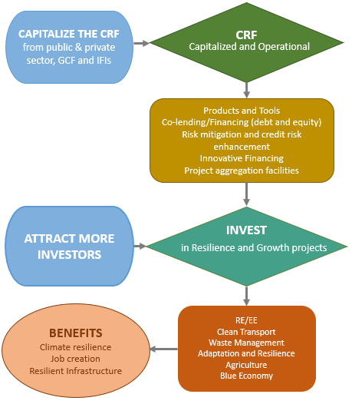
The Mechanics of establishing and operationalizing the CRF
Capitalized and Operational
in Resilience and Growth projects

Slide 14
The Way Forward
In the near future, ECLAC will convene an Expert Group Meeting for feedback and finalization of the CRF debt proposal
The finalized CRF proposal will be share with the Prime Ministers of the pilot countries (Antigua and Barbuda, Saint Lucia and Saint Vincent and the Grenadines) to garner their continued support and to agree on a plan of action to establish the CRF
Collaborations with IFIs, the GCF, CDB and IDB, elements of the private sectors and other relevant agencies will be conducted to continue to advocate for support for the establishment of the CRF within the global discussions on FFD during the COVID pandemic and beyond and also to generate initial financing for the proposed CRF
Collaborate with member States for the refined CRF to be launched as a viable agency based on an agreed structure
Continue to develop and initiate new innovative financing instruments under the CRF

Slide 15
Thank you!

